Slide 1
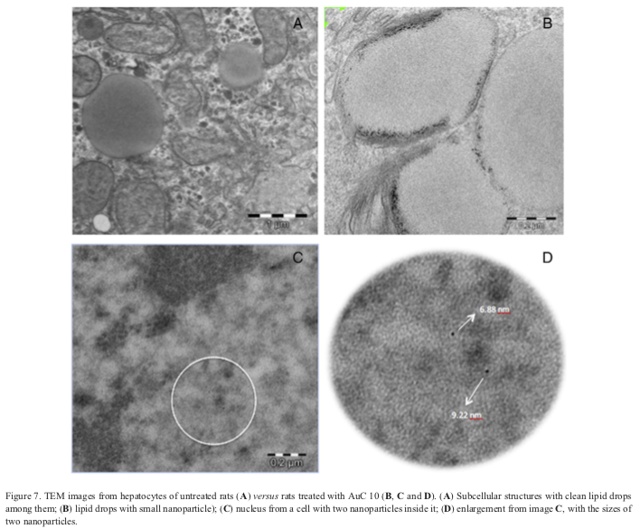
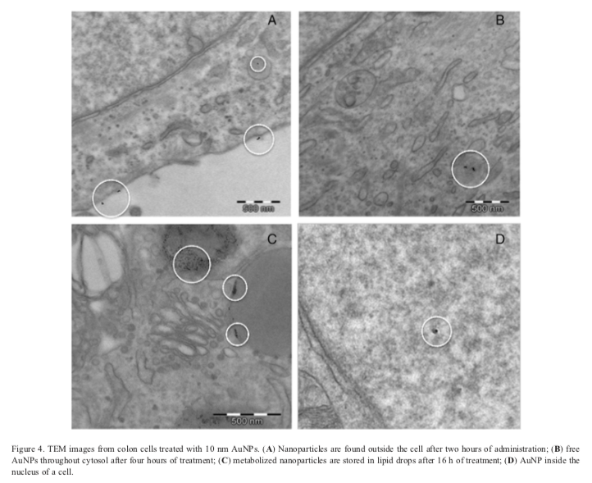
Gold nanoparticles: Distribution, bioaccumulation and toxicity. In vitro and in vivo studies
METHOD
Intestine cell cultures and liver samples were fixed with fresh primary fixative (1.5% glutaraldehyde, 1.0% formaldehyde in 0.05 M sodium cacodylate buffer, pH 7.4) and post-fixed with secondary fixative (1% osmium tetroxide, 1% potassium
ferrocyanide in Milli Q water) followed by dehydration with ascending series of alcohol before embedding samples in epoxy resin. Ultra thin sections were cut and doubly stained with uranyl acetate and lead citrate. A transmission electron microscope LIBRA 120 PLUS microscope at 120 kV (Carl Zeiss SMT., Oberkochen, Germany) was used to determine the fate and uptake of AuNPs into cells
- RESULTS
After administering the nanoparticles to the animals, slides of liver samples were observed by transmission electron microscopy. As shown in Figure 7, AuNPs were stored in lipid drops; although the size of these nanoparticles was smaller than the original ones (~6-8 nm). Some single, non-aggregated AuNPs were also found dispersed throughout the cytosol.
In the case of the organs exposed to 10 nm AuNPs, some nanoparticles were able to cross the nucleus membrane and were found inside it.
AIM
Clarify (both in vitro and in vivo) the tissue distribution, subcellular location and deleterious effects of three different sizes of AuNPs by means of the analysis of the content of Au in tissues, image studies and the determination of oxidative stress, inflammatory and tissue damage markers.
- GOLD NPs
The reference values obtained by TEM were 8.9 ± 0.1, 27.6 ± 2.1, and 56.0 ± 0.5 nm respectively. In order to confirm the presence of monodisperse Au nanoparticles, the purchased materials were regularly checked in our laboratory.
Lopez-Chaves C, et al, Gold nanoparticles: Distribution, bioaccumulation and toxicity. In vitro and in vivo studies. Nanomedicine: NBM 2018;14:1-12.

